Slide 1


Acceptance Problem for CFGs
Let $A\text{CFG} =\{〈G,w〉| G \text{is} \text{a} \text{CFG} \text{and} w∈L\left(G\right)\}$
Theorem: $\text{A}\text{CFG}$is decidable
Proof: Give TM $D\text{A}\text{−}\text{CFG}$ that decides $A\text{CFG}$ .
$D\text{A}\text{−}\text{CFG}=$ “On input $〈G,w〉$
Convert $G$ into CNF.
Try all derivations of length $2|w|−1$.
Accept if any generate $w$. Reject if not.
Corollary: Every CFL is decidable.
Proof: Let $A$ be a CFL, generated by CFG $G$.
Construct TM $M_{G}=$“on input $w$
1. Run $D\text{A}\text{−}\text{CFG}$ on $〈G,w〉$.
2. Accept if $D\text{A}\text{−}\text{CFG}$ accepts Reject if it rejects.”
Recall Chomsky Normal Form (CNF) only allows rules: A $→$ BC
B $→$ b
Lemma 1: Can convert every CFG into CNF.
Proof and construction in book.
Lemma 2: If $H$ is in CNF and $w∈L(H)$ then every derivation of $w$ has $2|w|−1$ steps.
Proof: exercise.

Slide 2


Emptiness Problem for CFGs
Let $E\text{CFG}$ $=\{〈G〉| G$ is a CFG and $L\left(G\right)=∅ \}$
Theorem: $E\text{CFG}$is decidable
Proof: $D\text{E}\text{−}\text{CFG}=$ “On input $〈G〉$ [IDEA: work backwards from terminals]
Mark all occurrences of terminals in $G$.
Repeat until no new variables are marked
Mark all occurrences of variable A if A $→B_{1}B_{2}⋯B_{k}$ is a rule and all $B_{i}$ were already marked.
Reject if the start variable is marked. Accept if not.”
S $→$ RTa
R $→$ Tb
T $→$ a
S
R
T
a
R
T
b
T
a

Slide 3
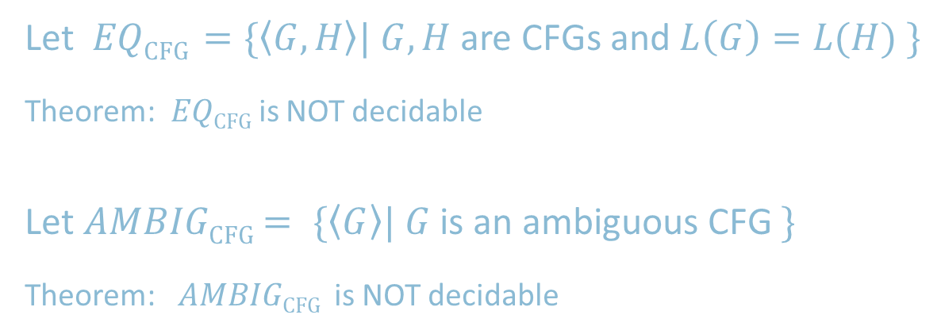
Equivalence Problem for CFGs
Let $EQ\text{CFG}$ $=\{〈G,H〉| G,H$ are CFGs and $L\left(G\right)=L(H) \}$
Theorem: $EQ\text{CFG}$is NOT decidable
Let $AMBIG\text{CFG}$ $= \{〈G〉| G$ is an ambiguous CFG $\}$
Theorem: $AMBIG\text{CFG}$ is NOT decidable

Slide 4



Recall $A\text{CFG}$
Recall: $A\text{CFG}$ $=\{〈G,w〉| G \text{is} \text{a} \text{CFG} \text{and} w∈L\left(G\right)\}$
Theorem: $A\text{CFG}$ is decidable
Proof: $D\text{A}\text{−}\text{CFG}=$ “On input $〈G,w〉$
Convert $G$ into Chomsky Normal Form.
Try all derivations of length $2|w|−1$.
Accept if any generate $w$. Reject if not.
Chomsky Normal Form (CNF): A $→$ BC
B $→$ b
Let’s always assume $G$ is in CNF.

Slide 5





Attempt to show $A\text{CFG}∈$ P
Theorem: $A\text{CFG}∈$ P
Proof attempt:
Recursive algorithm $C$ tests if $G$ generates $w$, starting at any specified variable R.
$C=$“On input $〈G,w,\text{R}〉$
1. For each way to divide $w=xy$ and for each rule R $→$ST
2. Use $C$ to test $〈G,x,\text{S}〉$ and $〈G,y,\text{T}〉$
3. Accept if both accept
4. Reject if none of the above accepted.”
Then decide $A\text{CFG}$ by starting from $G$’s start variable.
$C$ is a correct algorithm, but it takes non-polynomial time.
(Each recursion makes $O(n)$ calls and depth is roughly $log⁡n$.)
Fix: Use recursion + memory called Dynamic Programming (DP)
Observation: String $w$of length $n$ has $O(n^{2})$ substrings $w_{i}⋯w_{j}$
therefore there are only $O(n^{2})$ possible sub-problems $〈G,x,\text{S}〉$ to solve.
R
S
T
$$x$$
$$y$$
$$w$$

Slide 6
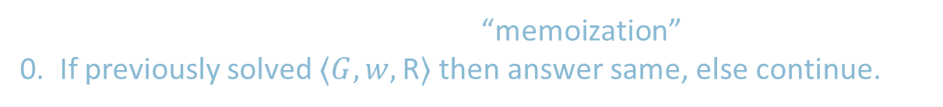




DP shows $A\text{CFG}∈$ P
Theorem: $A\text{CFG}∈$ P
Proof : Use DP (Dynamic Programming) = recursion + memory.
$D=$“On input $〈G,w,\text{R}〉$
“memoization”
0. If previously solved $〈G,w,\text{R}〉$ then answer same, else continue.
1. For each way to divide $w=xy$ and for each rule R $→$ST
2. Use $D$ to test $〈G,x,\text{S}〉$ and $〈G,y,\text{T}〉$
3. Accept if both accept
4. Reject if none of the above accepted.”
Then decide $A\text{CFG}$ by starting from G’s start variable.
same as before
R
S
T
Total number of calls is $O(n^{2})$ so time used is polynomial.
Alternately, solve all smaller sub-problems first: “bottom up”
$$x$$
$$y$$
$$w$$

Slide 7



$A\text{CFG}∈$ P & Bottom-up DP
Theorem: $A\text{CFG}∈$ P
Proof : Use bottom-up DP.
$D=$“On input $〈G,w〉$
1. For each $w_{i}$and variable R Solve $〈G,w_{i},\text{R}〉$ by checking if R $→w_{i}$ is a rule.
2. For $k=2,…, n$ and each substring $u$ of $w$ where $\left|u\right|=k$ and variable R
Solve $〈G,u,\text{R}〉$ by checking for each R $→$ST and each division $u=xy$
if both $〈G,x,\text{S}〉$ and $〈G,y,\text{T}〉$ were positive.
3. Accept if $〈G,w,\text{S}〉$ is positive where S is the original start variable.
4. Reject if not.”
Total number of calls is $O(n^{3})$ so time used is polynomial.
Often, bottom-up DP is shown as filling out a table.
Solve for substrings of length 1
Solve for substrings of length $k$ by using previous answers for substrings of length $<k$.

